Slide 1
PJM Footprint ROundtable
Grid Modernization in PJM States: Enabling the Grid, Utility and Prosumer of the Future
Betty Ann Kane, Chairman
DC Public Service Commission
November 29, 2018

Slide 2
DC PSC Interests and Initiatives
Retail Choice
Rooftop Solar
Advanced Metering Infrastructure
Distribution Automation
Renewable Portfolio Standards

Slide 3
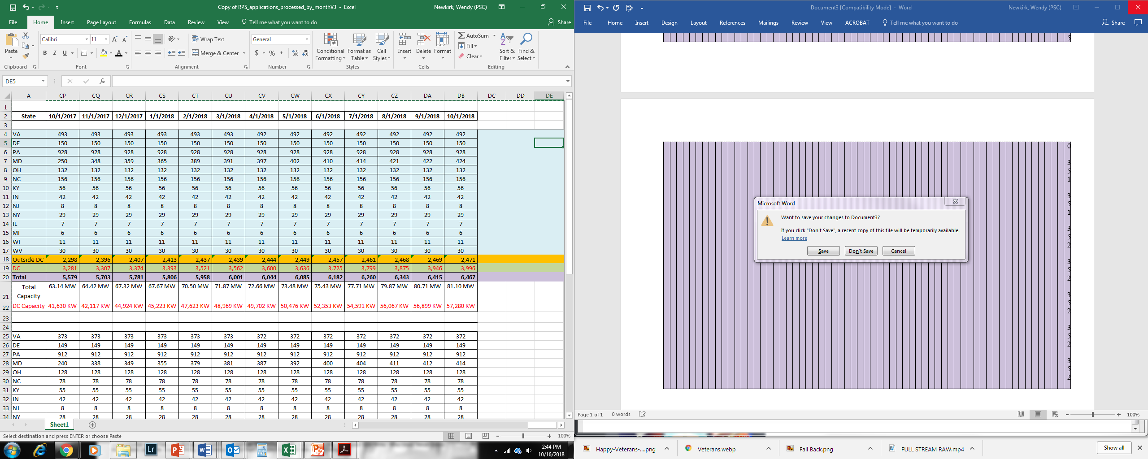
STATUS REPORT NUMBER SOLAR FACILITIES CERTIFIED FOR THE DISTRICT AND PJM TO DATE
(NOS ARE CUMULATIVE)
Total Number of Solar Energy Systems Cont.

Slide 4
The Renewable Energy Portfolio Standard (“RPS”) Act, established a minimum percentage of District electricity providers’ supply must be derived from renewable energy sources.

Slide 5
Delivery System Impacts
DC PLUG
Capital Grid
Project Pipes
Transportation Electrification

Slide 6
Formal Case 1130 - Modernizing the Energy Delivery System for Increased Sustainability

Slide 7

MEDSIS VISION STATEMENT
The District of Columbia’s modern energy delivery system must be
  Sustainable,
  Well-planned,
  Encourage distributed energy resources, and
  Preserve the financial health of the energy utilities in a manner that results in an energy delivery system that is
    Safe and reliable,
    Secure,
    Affordable,
    Interactive, and
    Non-discriminatory

Slide 8
MEDSIS WORKING GROUPS
WG 1: Data and Information Access and Alignment
WG2: Non-wire Alternatives to Grid Investments
WG3: Future Rate Design
WG4: Customer Impact
WG5: Microgrids
WG6: Pilot Projects

Slide 9
Who is a Generator?
Who is a Distributor?
Who is a Consumer?

Slide 10
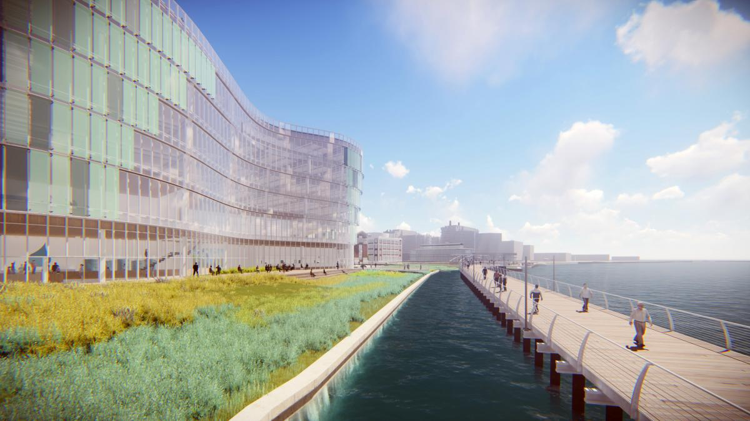
Alternative energy will be supplied by an innovative sewer heat recovery system.

Slide 11
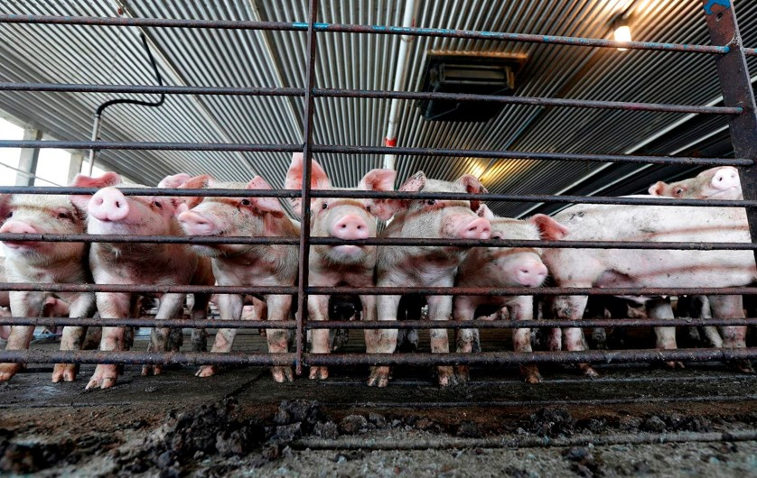
Companies Launch Plan To Capture Methane From Hog Manure Lagoons.
Smithfield and Dominion join to capture methane emissions
that contribute to climate change.

Slide 12


Slide 13

Public Service Commission of the District of Columbia
1325 G Street, NW, Suite 800
Washington, D.C. 20005
(202) 626-5100
www.dcpsc.org
www.dcgridmod.com

